Slide 1

RAGHU ENGINEERING COLLEGE
(AUTONOMOUS)
DEPARTMENT OF EEE
Academic year: 2018-2019
II year 2-semester
Power systems
CASE STUDY
ON
Distribution system
FACULTY:
Mrs.V. Pramadha Rani
Associate professor
BATCH-3
18985A0246 – K.Karthik
18985A0247 – L.Ratnakara Rao
18985A0248 – M.Gaddim Naidu
18985A0249– M.Jagapathivarma
18985A0250 – M.Sai

Slide 2
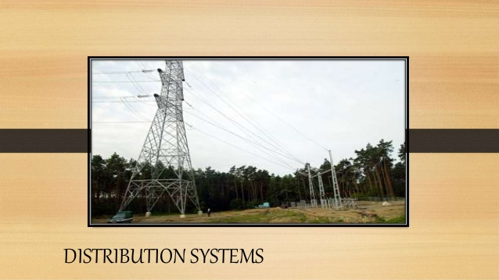

Slide 3
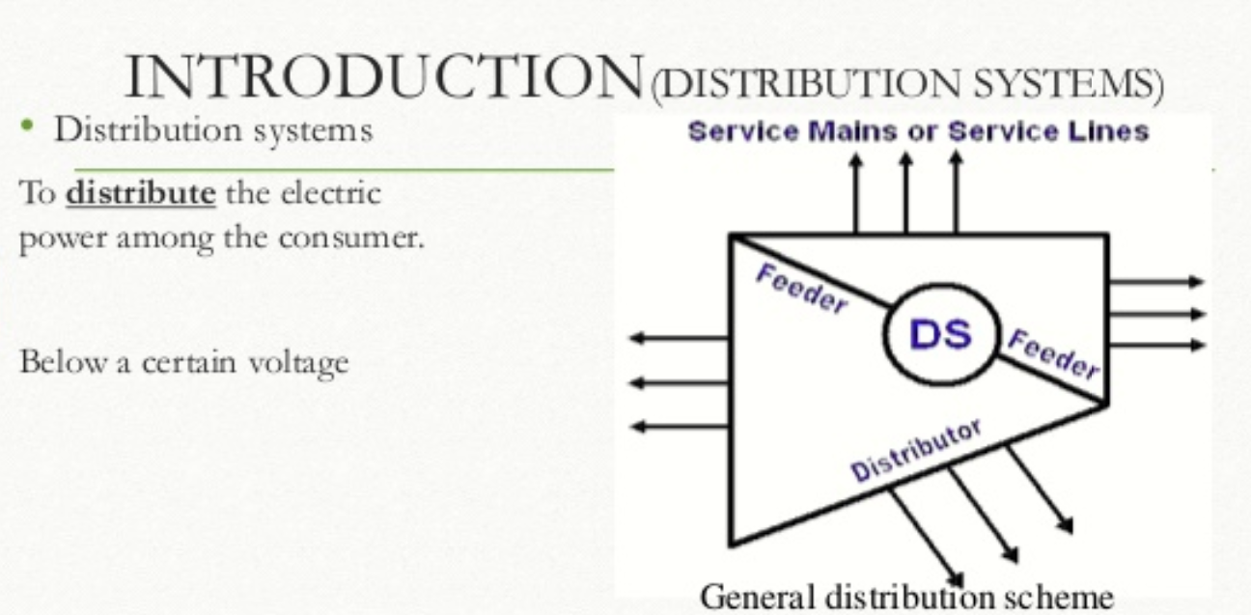

Slide 4
Distribution system Distribution system is nothing but the conductor system by which electrical energy is conveyed from a substation to the consumer is called Distribution system

Slide 5
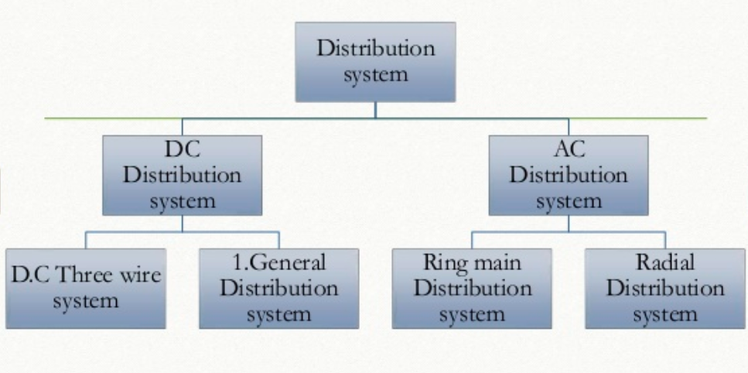
Classification Of Distribution system

Slide 6
Types of distribution system
primary distribution : The part of the electrical supply system existing between the distributions transformers is called the primary system.
secondary distribution : The secondary distribution system receives power from the secondary side of distribution transformers at low voltage and supplies power to various connected loads via service lines.

Slide 7
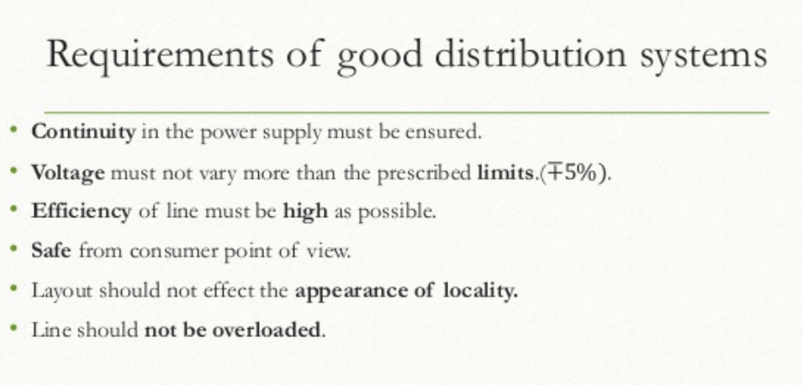

Slide 8
DC distribution system
General distribution system :
Feeder are used to feed the electrical power from the generating station to the substation.
Distributors are used to distribute the supply further from the substation.
Service mains are connected to the distributors so as to make the supply available at the consumers. (simplest two wire distribution system)

Slide 9
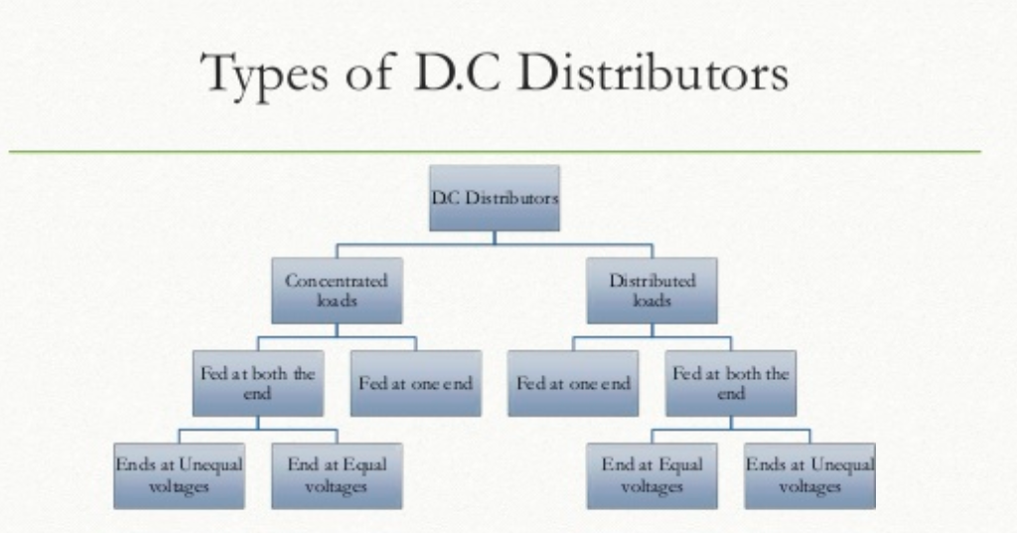

Slide 10
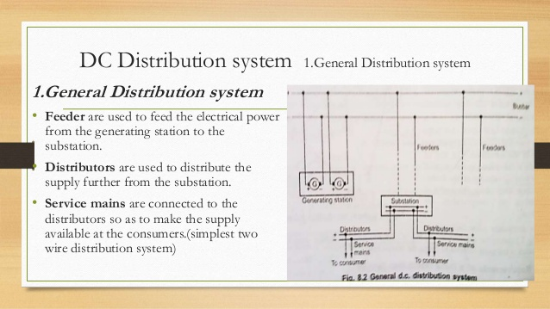

Slide 11
DC 3-wire system
Voltage level can not be increased readily like a.c.
Method :- two generations are connected in series
- each is generating a voltage of V volts
-common point is neutral from where
neutral wire is run.
Demand :- consumers demanding higher voltages are connected to the two lines.
- consumers demanding less voltage are connected between any one line and neutral.

Slide 12
AC Distribution system
Radial distribution system
only one /single path is connected between each distribution and substation is called radial distribution system.
Fault occurs either on feeder or a distribution , all the consumers connected to that distributor will get affected .
In india,99% of distribution of power is by radial distribution system only.

Slide 13
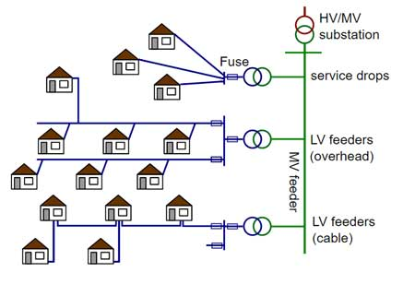
Radial distribution system

Slide 14
Advantages
Its initial cost is minimum.
Simple in planning, design and operation.
Useful when the generation is at low voltage.
Station is located at the center of the load.
Disadvantages
Distributor nearer to the feeding end is heavily loaded.
The consumers at the far end of the feeder would be subjected to series voltage fluctuations with the variations in load.

Slide 15
Ring main distribution system
Feeder covers the whole area of supply in the ring fashion and finally terminates at the substation from where it is starred.
Closed loop form and looks like a ring.
The feeder in this system forms a loop which starts from substation bus bars, runs through the load area feeding distribution transformer and returns to the substation bus bars.

Slide 16
Advantages
less conductor material is required as each part of the ring carries less current than in the radial system.
less voltages fluctuations.
Disadvantages
it is difficult to design when compared to the designing of a radial system.

Slide 17
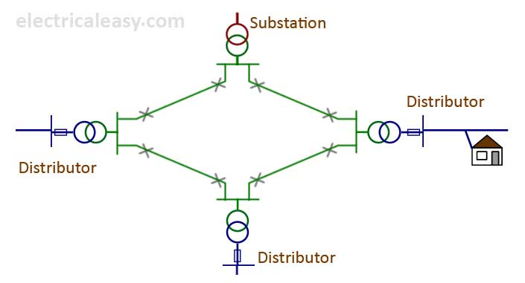

Slide 18
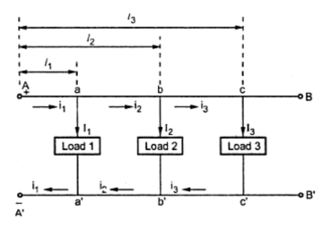
DC Distributor with concentrated loads
Fed at one end
The distributor with concentrated loads are fed at one end A-A’.
The potential getting reduced goes away from the feeding point.
Load connected in the each distributor can vary the previous supply of voltage
Small load variation can change
Overall distributor parameters

Slide 19

2. Fed at both the ends (concentrated loads)
End at equal voltages.
A and B maintained at equal voltage
‘b’ be the point of minimum potential (the load point where the current are coming from both the side of distributor is the point of minimum potential.
After b the voltage goes on increasing till it becomes feeding voltage at B.

Slide 20
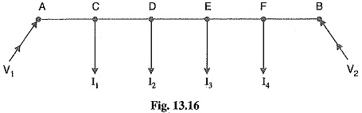
2.End at unequal voltages
A and B maintained at different voltages.
‘b’ be the point of minimum potential.

Slide 21
DC distributor with uniformly distributed load
Fed at one end
Fed at equal voltages
1 End at equal voltages

Slide 22
2. End at unequal voltages
The distributor AB fed with unequal voltages, end A being fed with V₁volts and end B with V₂ volts.
Voltage drop in AB=V₁ –V₂
Advantages of AC distribution
cheaper transformation between voltages
Easy to switch off
Less equipment needed
More economical in general
Rotating field

Slide 23
Thank you

